Slide 1
MAJOR PROJECT • VOIS AICTE BATCH 1 (2026–27)
Seasonal Agriculture
Performance Analysis
How does agricultural performance vary across seasons?
Student Name: Pranjal Sharma College: KIET Group of Institutions AICTE Student ID: STU6783d8ba6e8881736693946

Slide 2
Problem Statement
Why does performance change across seasons?
Seasonal environmental conditions — rainfall, temperature, humidity
Water availability and irrigation practices
Fertilizer / pesticide and other resource usage
Crop selection specific to each cropping season
Market conditions such as price, revenue and cost
The Problem Raw agricultural data does not, by itself, explain how performance changes across seasons. This project analyzes the seasonal agriculture dataset to uncover meaningful seasonal patterns, trends and relationships in agricultural performance.
Central Research Question “How does agricultural performance vary across seasons?” — this question drives every stage of analysis in this project, from exploratory data analysis through to statistical hypothesis testing.
Seasonal Agriculture Performance Analysis
1

Slide 3
Project Description
Project Overview This project analyzes farm-level agricultural data to understand how performance varies across the Kharif, Rabi and Zaid seasons. It follows a complete data-analytics workflow — from raw data to statistically validated conclusions — using a single, actual dataset of Indian farm records.
Dataset at a Glance
4,000
28
Farm Records
Features
The analysis examines
3
8
Yield & production performance
Water usage & efficiency
Environmental conditions
Resource utilization (fertilizer, pesticide)
Economic performance (revenue, cost, profit)
State-wise & crop-wise performance
Statistical significance of seasonal gaps
Seasons
States
8
4
Crops
Irrigation Types
Seasonal Agriculture Performance Analysis
2

Slide 4
Who Are the End Users?
Farmers
Agricultural Planners
Analysts / Researchers
Government Departments
Agri-business / Supply Chain
Compare seasonal crop performance
Identify profitable / weak seasons
Support seasonal planning
Identify regional patterns
Study environmental & resource links
Analyze seasonal trends
Evidence-based agricultural policy
Track regional performance
Anticipate seasonal availability
Plan production & logistics
Why it matters Understanding seasonal performance differences helps every stakeholder along the agricultural value chain make more informed, evidence-based decisions.
Seasonal Agriculture Performance Analysis
3

Slide 5
Technology Used
Python
Jupyter Notebook
Pandas
NumPy
Matplotlib
Seaborn
SciPy (Statistics)
Analytical Workflow
Data
Cleaning
→
EDA
→
Visualization
→
Statistical
Testing
→
Insights &
Recommendations
Data Analysis → Data Cleaning → EDA → Visualization → Statistical Testing → Insights
Seasonal Agriculture Performance Analysis
4

Slide 6
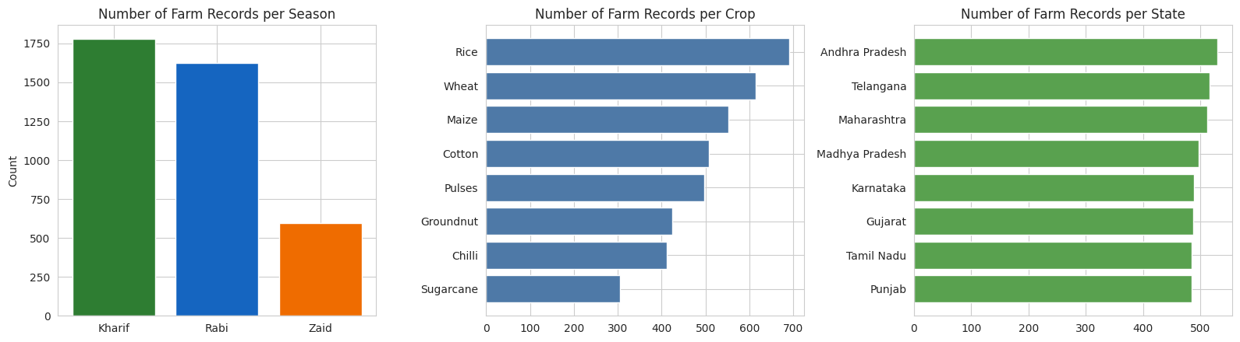
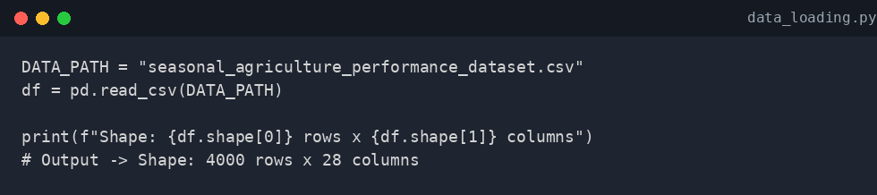
Results: Dataset Overview & EDA
Dataset Summary
Observations (rows) | 4,000
Variables (columns) | 28
Categorical variables | 6 (State, District, Crop, Season, Irrigation Method, Farm ID)
Numerical variables | 22 (environmental, resource & economic measures)
Season categories | Kharif, Rabi, Zaid
States / Crops | 8 states / 8 crops
What it represents: Distribution of farm records across seasons, crops and states.
Observation: Kharif and Rabi contribute the most records; Zaid, the shortest cropping season, contributes noticeably fewer. Rice and Wheat are the most frequent crops.
Data Cleaning
Agricultural Insight: The dataset offers reasonably broad seasonal, crop and geographic coverage for a meaningful seasonal comparison.
Missing values found: Rainfall_mm (48), Soil_Moisture_pct (40), Yield_Tonnes_Ha (32) Duplicates: 0 duplicate rows, 0 duplicate Farm IDs Treatment: Missing values imputed using group-wise median — Rainfall & Soil Moisture by Season, Yield by Crop — 0 missing values remain.
Loads the dataset and confirms its size (4,000 × 28).
Results — Dataset & Exploratory Data Analysis
5

Slide 7
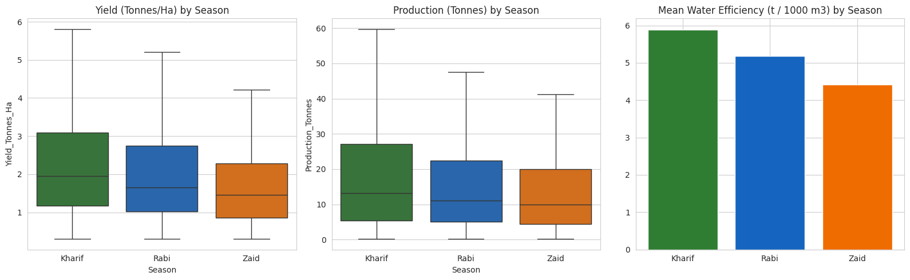
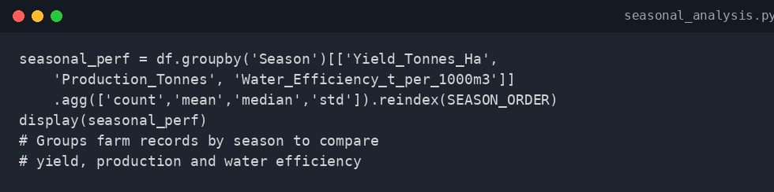
Results: Seasonal Performance
Mean Values by Season
Season | Yield (t/ha) | Prod. (t) | Water Eff.
Kharif | 5.63 | 46.31 | 5.89
Rabi | 5.10 | 41.49 | 5.19
Zaid | 4.64 | 38.89 | 4.41
Key Seasonal Insight Kharif demonstrates the strongest overall agricultural performance, while Zaid shows the weakest performance across yield, production and water efficiency in the analyzed dataset.
What it represents: Comparison of yield, production and water-use efficiency across Kharif, Rabi and Zaid (outliers hidden for readability).
Observation: Kharif records the highest median and mean on all three measures, Rabi is second, and Zaid is consistently the lowest.
Agricultural Insight: Seasonal conditions are associated with meaningfully different agricultural outcomes, not just a difference in one metric.
Results — Seasonal Performance (Central Question)
6

Slide 8
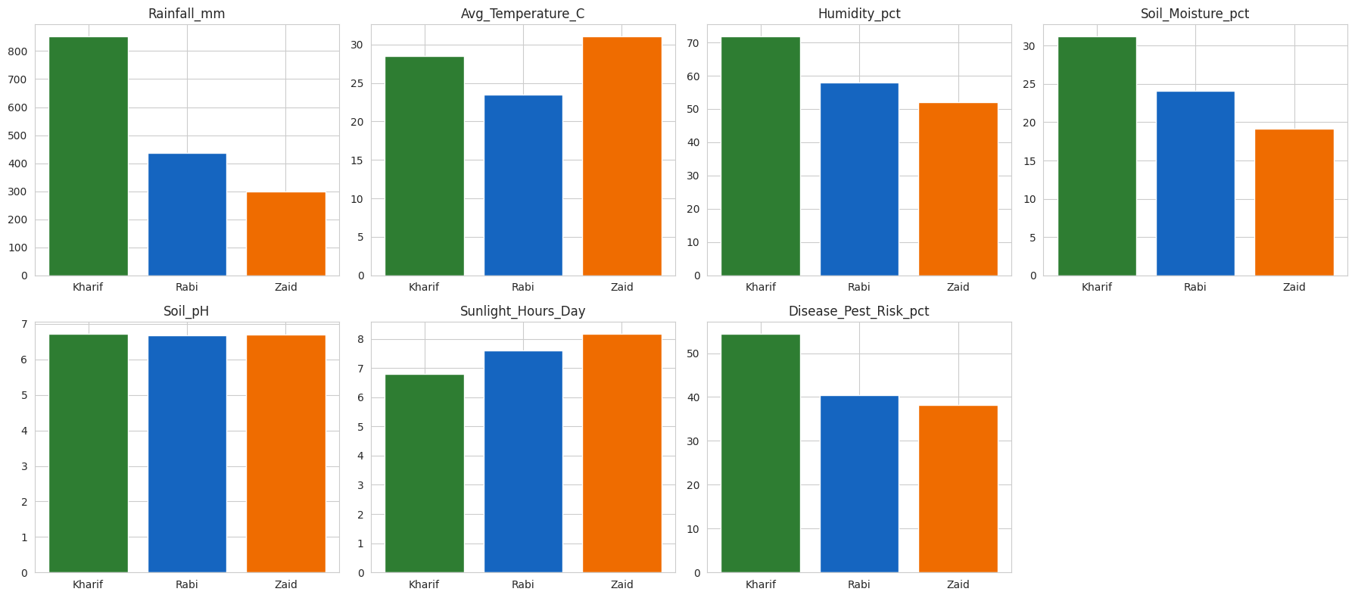
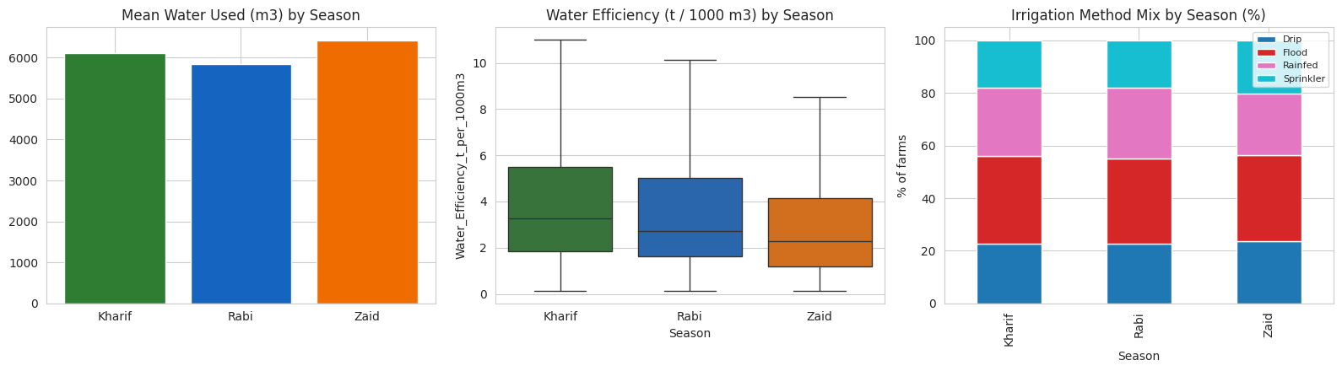
Results: Environmental & Resource Analysis
Resource Utilization
Season | Water Used (m³) | Water Eff. | Fertilizer
Kharif | 6,102 | 5.89 | 187.1
Rabi | 5,847 | 5.19 | 185.4
Zaid | 6,420 | 4.41 | 184.6
What it represents: Mean environmental conditions (rainfall, temperature, humidity, soil moisture, etc.) by season.
Resource & Climate Insight Zaid uses the most water on average yet achieves the lowest water-use efficiency, while Kharif uses comparatively less water for the highest efficiency — pointing to climate rather than irrigation-method mix as the likely driver.
Observation: Rainfall, humidity and soil moisture fall sharply from Kharif to Zaid, while temperature and sunlight hours rise — matching monsoon → winter → dry-summer progression.
Agricultural Insight: Water availability drops precisely in the season (Zaid) where performance is weakest, a plausible contributing factor.
Results — Environment & Resources
7

Slide 9
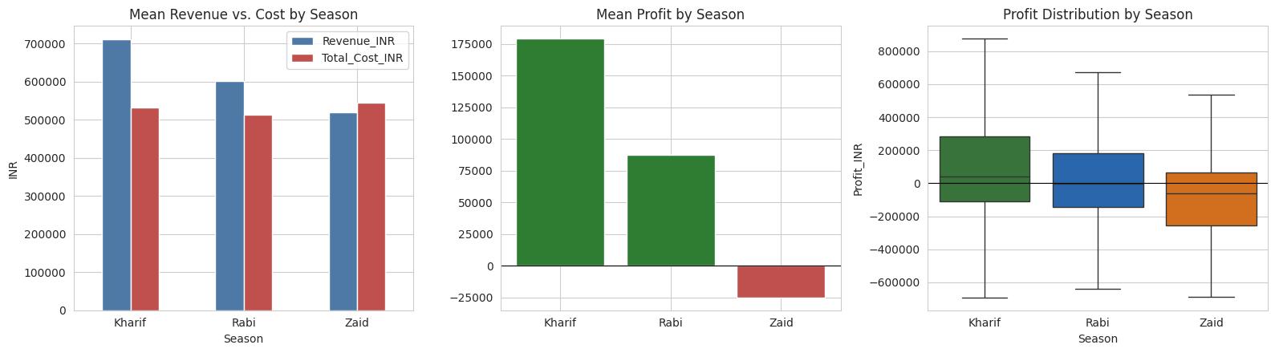
Results: Economic Performance
Mean Economic Indicators (₹)
Season | Revenue | Cost | Profit
Kharif | 7,10,719 | 5,31,804 | 1,78,915
Rabi | 6,01,526 | 5,13,837 | 87,689
Zaid | 5,19,172 | 5,43,977 | –24,805
Median Profit (₹): Kharif 38,808 | Rabi –3,187 | Zaid –62,144
What it represents: Mean revenue vs. cost, mean profit, and the spread of profit by season.
Observation: Mean revenue declines steadily from Kharif to Rabi to Zaid, while mean cost stays fairly flat (slightly higher in Zaid) — so mean profit is strongly positive in Kharif, modest in Rabi, and negative in Zaid.
Economic Insight Seasonal profitability is influenced not only by market price but also by production/revenue levels and costs; Zaid-season farms show a negative average profit in this dataset.
Agricultural Insight: Since average market price is nearly identical across seasons (₹44,000–₹45,000/tonne), the profit gap is driven by output and cost — not by farmers receiving a lower price in weaker seasons.
Results — Economic Performance
8

Slide 10
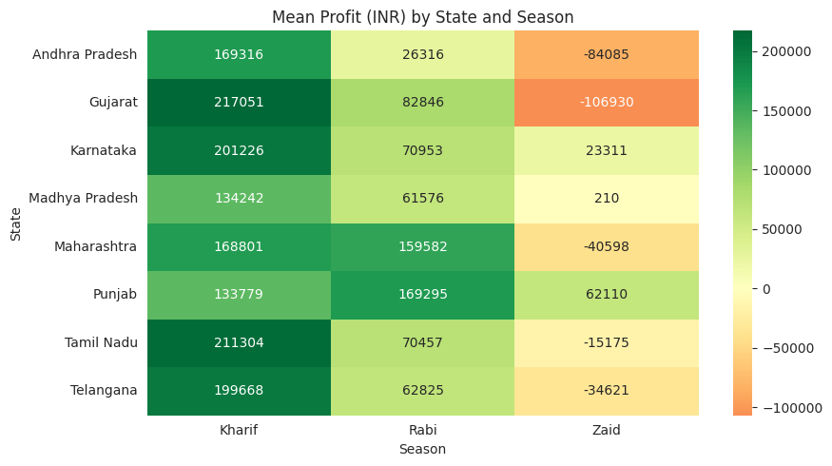
Results: Regional & Crop Analysis
Crop × Season Profit Pattern (₹)
Crop | Kharif | Rabi | Zaid
Chilli | 9,54,380 | 6,38,572 | 4,48,659
Cotton | 2,17,000 | 1,07,344 | –53,925
Sugarcane | 10,00,791 | 7,31,613 | 5,83,636
Rice | –64,903 | –98,428 | –227,239
Wheat | –105,872 | –119,955 | –193,209
The best season is not identical for every crop — the same Kharif–Zaid gap appears within most individual crops too, reinforcing that season itself (not just crop mix) drives the difference.
Regional & Crop Insight Because the pattern holds broadly across states and crops, seasonal recommendations (e.g. caution around Zaid profitability) are reasonable to generalize — while crop-specific, state-specific context should still refine local planning.
What it represents: Mean profit (₹) broken down by State and Season.
Observation: Kharif is the most profitable season in 7 of 8 states, and Zaid is the least profitable season in all 8 states.
Agricultural Insight: The Kharif-strong / Zaid-weak pattern is a broad, cross-state effect rather than an artifact of one or two large states.
Results — Regional & Crop Analysis
9

Slide 11
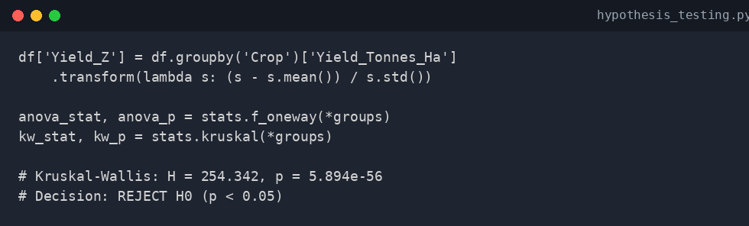
Statistical Findings: Hypothesis Testing
Hypothesis Test Setup
Test Results
H₀ (Null): No statistically significant difference in crop-adjusted yield performance across seasons. H₁ (Alternative): A statistically significant difference exists in crop-adjusted yield performance across at least one pair of seasons. Significance level: α = 0.05
Test | Statistic | p-value
Kruskal-Wallis (primary) | H = 254.342 | 5.89 × 10⁻⁵⁶
One-way ANOVA (reference) | F = 127.383 | 2.34 × 10⁻⁵⁴
Decision p-value (5.89×10⁻⁵⁶) ≪ 0.05 → REJECT H₀
Why Kruskal-Wallis?
Raw yield differs by scale across crops, so yield is first standardized within each crop (z-score) to isolate the seasonal effect. A Shapiro-Wilk test showed the standardized yield is not normally distributed (p ≈ 2.6×10⁻⁴), so the non-parametric Kruskal-Wallis test — which does not require normality — is the appropriate primary test. One-way ANOVA is reported alongside it for reference.
Contextual Interpretation Seasonal differences in crop-adjusted yield are statistically significant in this dataset, even after adjusting for differing crop mixes between seasons. This confirms with formal statistical support (not just visual impression) that Kharif performs best and Zaid performs worst. Important caveat: statistical significance does not, on its own, prove which environmental or resource mechanism causes the difference — it establishes association, not causation.
Statistical Findings & Insights
10

Slide 12
Key Findings & Recommendations
Key Findings
Data-Driven Recommendations
Kharif is strongest, Zaid weakest overall. Highest mean yield, production, water efficiency & profit in Kharif; lowest on every measure in Zaid.
Treat Zaid cultivation as higher financial risk Average/median profit is negative in Zaid; review cost control and crop choice.
Seasonal yield gap is statistically significant. Kruskal-Wallis p ≪ 0.05, even after crop-adjustment.
Prioritize water-efficiency measures in Zaid Same irrigation mix as other seasons but lowest efficiency — targeted intervention may help most here.
Zaid shows negative average profit. Driven by lower output/efficiency, not lower market price.
Plan at crop × season level, not season alone Best season differs by crop; a blanket “avoid Zaid” rule may not suit every crop.
Zaid is least water-efficient. Highest water use but lowest tonnes produced per 1000 m³.
Manage pest/disease risk during Kharif Kharif has both the highest yield and the highest disease/pest risk — protecting it protects the most output.
Pattern holds broadly across states & crops. Kharif-best / Zaid-worst repeats in most states and crops individually.
Limitations (brief) Cross-sectional observational data with unequal sample sizes across seasons (Zaid n=594 vs. Kharif n=1,779); a small share of values were median-imputed; findings are correlational, not causal, and limited to the 8 states / 8 crops present in the dataset.
Key Findings & Recommendations
11

Slide 13
Future Scope
Multi-Year Data
Predictive Modeling
Real-Time Weather Integration
Incorporate multiple years of records to identify long-term seasonal trends rather than a single-year snapshot.
Build ML models to forecast yield, profit, water requirement and seasonal risk.
Connect live weather feeds to refine seasonal risk assessment.
Crop Recommendation System
Interactive Dashboard
Regional-Level Forecasting
Develop crop-season recommendation engines based on farm conditions.
Build a Power BI / Streamlit dashboard for farmers and planners.
Provide district / state-specific agricultural forecasts.
Seasonal Agriculture Performance Analysis
12

Slide 14

GitHub Repository
Student: Pranjal Sharma Project: Seasonal Agriculture Performance Analysis Repository:
github.com/sharmapranjal99/Vois-and-Vodafone-Idea-Foundation-final-project
Scan the QR code to view the complete project code, notebook and documentation.
Scan for GitHub
Seasonal Agriculture Performance Analysis
13

Slide 15

VOIS Course Completion Certificate
VOIS Course Completion Certificate — Data Visualization
Seasonal Agriculture Performance Analysis
14

Slide 16
Thank You
Questions & Discussion
Pranjal Sharma | KIET Group of Institutions | Seasonal Agriculture Performance Analysis

